Slide 1

Capstone Project

Slide 2



Personal BACKGROUND
(Name, Past Experience, Qualification, Career Summary)
Name :Lade Vivek
Past Experience : Fresher
Qualification : B Tech Computer Science
Career Summary : Data Analyst skilled in Power BI, DAX, ETL, SSIS, SQL, Python, and Power Query. Skilled in building interactive dashboards, data models, and reports to support decision-making. Trained in managing ETL processes and integrating data from various sources using SSIS. Strong in SQL for querying and optimizing databases and using Python for file handling and data conversion. Capable of transforming complex data into clear insights. Continuously learning and adapting to new technologies to deliver effective solutions.
www.collaberadigital.com

Slide 3

Key Takeaways/Learnings from the Program (HTD)
SQL | Python | Soft Skills | Data Engineering & ETL Techniques | Power BI
Basics to Advanced SQL, Window Functions, Practical SQL Command Usage, Joins, Subqueries, Views, Performance Tuning | Basics of Python, File Handling (Read/Write), Pandas for Data Manipulation, Regular Expressions, Data manipulation with Pandas | Time Management, Critical Thinking, Problem Solving, Creative Problem-Solving, Communication Skills | ETL Tool (SSIS), Incremental Loading Techniques, Various Data Models & Methods, Hands-on Experience with Different ETL Scenarios | Data Cleaning, Data Modelling, M Language, Advanced DAX and Power Query, Visualizations for Reports

Slide 4

Problem Statement of the Capstone Project
Created a calendar table as it is essential for visualizing sales data properly.
Conducted an in-depth analysis of the sales data to reveal hidden patterns and trends.
This analysis involved exploring customer purchasing behaviors, identifying top-selling products, and examining seasonal variations. By understanding these factors,
We aim to gain valuable insights that can support strategic planning, optimize inventory management, and improve overall sales performance.

Slide 5

Completed Task
Date Generation: Generated dates based on the database by extracting the minimum and maximum years and creating a date range using (List.Dates).
Calendar table:Created a calendar table using DAX to support various date formats such as DD, MM, and YYYY, ensuring flexibility in visualizing sales data according to different reporting needs.
Invoke Function: Developed an invoke function to process text files by adding new columns such as store location, store number.
Report Page Contribution: Contributed to Report Page 1 by creating DAX measures for analysis, interactive bookmarks for navigation, and various visuals including line charts to show trends, donut charts for categorical data distribution, and title cards for clarity. Developed detailed tables for in-depth data exploration about sales and applied appropriate visualizations to effectively convey insights.

Slide 8

Challenges Faced During Capstone
Bookmark Creation Confusion:
Difficulty in managing selections for bookmarks and navigation.
Verifying Measures Accuracy:
Struggled to confirm the correctness of measures like Gross Profit, Margins, and YTD values due to fluctuating slicer data.
Product Analysis for Innovation vs. Standard:
Needed to classify products as "Innovative" or "Standard" based on product names and then visualize their Gross Profit and Margins.
Fetching Continent Name:
Could not retrieve the continent name for stores during data cleaning and modelling.

Slide 9

Bookmark Creation Confusion:
Referred to previous class files explained by the trainer and sought guidance from teammates to understand the bookmark and navigation setup.
Verifying Measures Accuracy:
Using consistent filters, checked calculations step-by-step, and compared with a set of known values to make sure numbers are accurate even when slicers change..
Product Analysis for Innovation vs. Standard:
Used two approaches to create the “Product Type" column:
Power Query: Applied the text delimiter function to identify innovative products.
DAX: Implemented the IF clause to categorize products based on their names.
Fetching Continent Name:
Extracted continent names from a separate folder containing store details to incorporate this information into the data model.
Overcome the challenges :

Slide 10
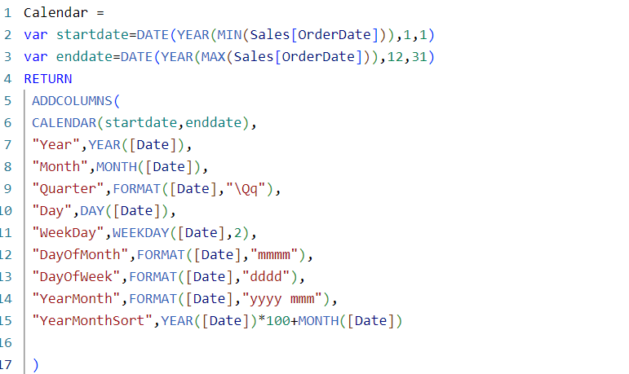
Created a DAX calendar table for flexible date format visualization

Slide 11
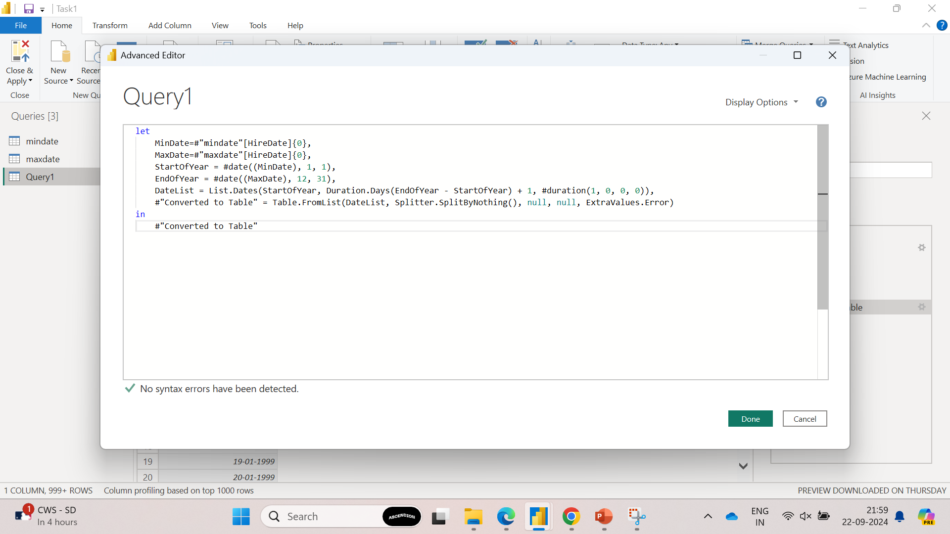
Using M language to generate dates based on the provided dataset

Slide 12
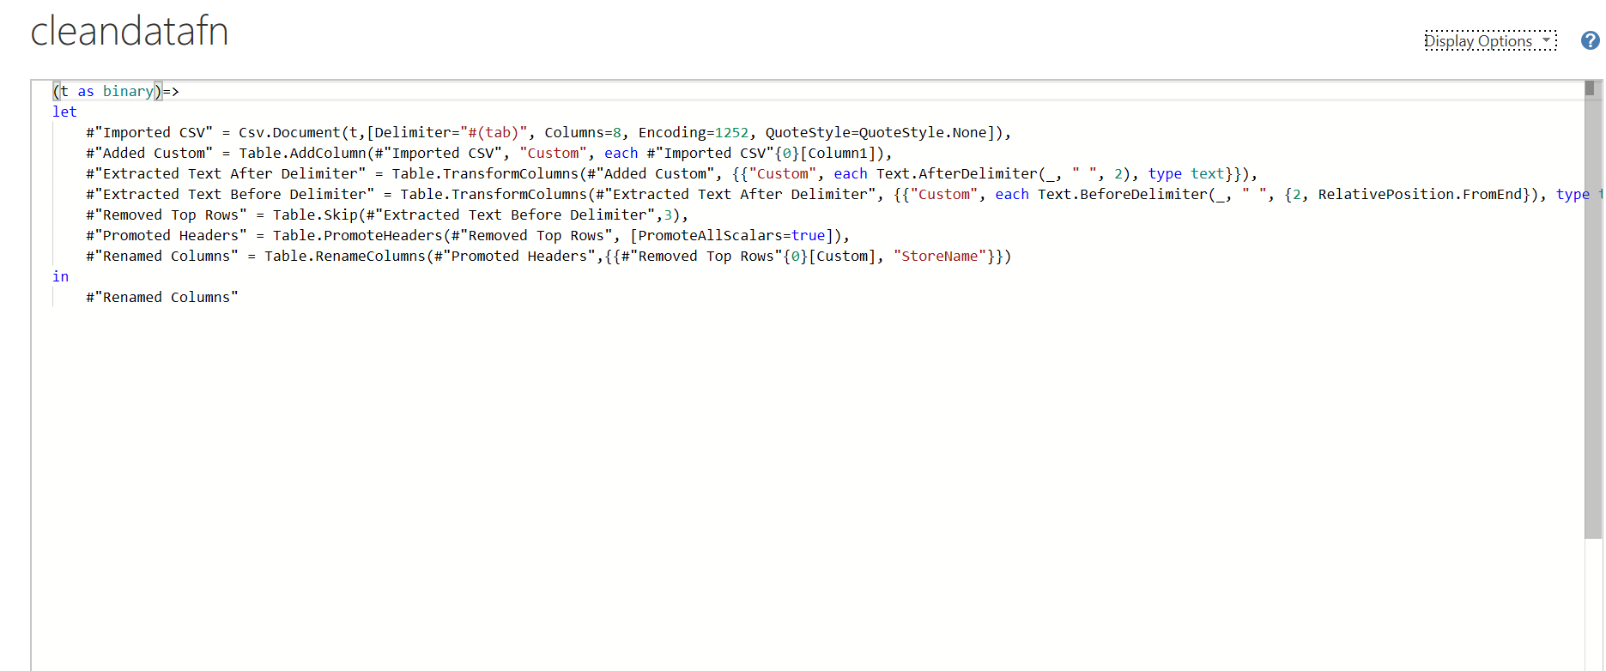
Created a Invoke function

Slide 13
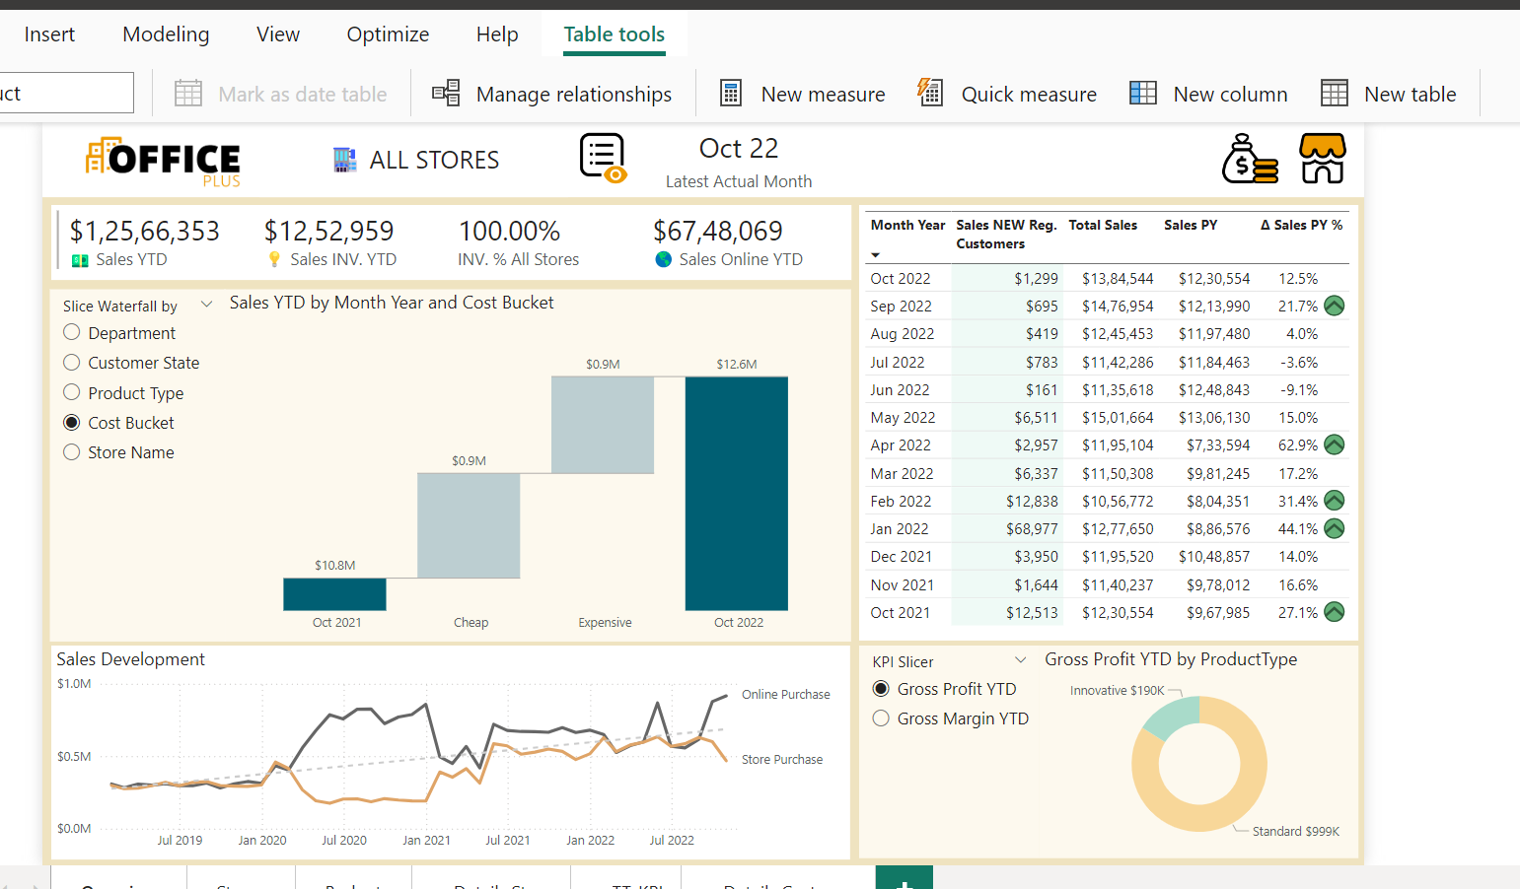
Created a Power BI report for sales visualization

Slide 14
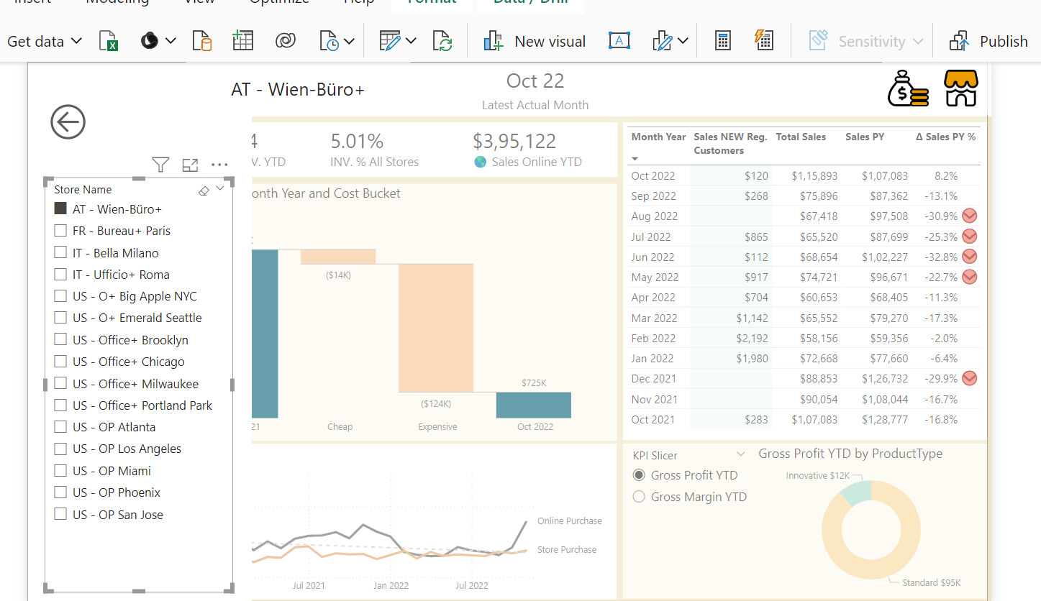
Created a Power BI report for sales visualization

Slide 15
The project involved creating a dynamic calendar table using DAX for flexible date formats and performing extensive data cleaning and modelling to ensure data accuracy. This allowed us to analyse sales data effectively, uncovering patterns like customer behaviours, high-performing products, and seasonal trends. These insights will support strategic decisions, optimize inventory management, and improve sales performance. Challenges with bookmarks, data verification, and categorization were overcome through teamwork and problem-solving, resulting in a comprehensive and impactful sales report.
Conclusion

Slide 16
Thank You

